Slide 1

Introduction to
John Culviner
GitHub: github.com/johnculviner
Blog: johnculviner.com
Twitter: @johnculviner
Email: john@johnculviner.com

Slide 2



About Me
Angular, JavaScript & .NET Consultant @ ILM
Been developing on .NET professionally ~6 years
Heavy JavaScript development ~4 years
  Manual, jQuery, Knockout.js, Durandal.js, Angular.js
  SPA development ~3 years
Open Source Street Cred
  jQuery File Download
  FluentKnockoutHelpers
  AngularAgility
    A set of useful Angular.js extensions implementing common UX patterns to improve productivity

Slide 3

Overview
What is Angular.js
Why should I care about Angular.js?
Angular.js features vs. other libraries
Why I like Angular.js / Didn't like Angular.js
Building a new social media site - FaceFolio
  $scope
  Directives
  Controllers
  Forms/Validation
  Ajax with $http/$resource
  Messaging with $scope .$emit/.$broadcast and .$on
  Building a simple directive
Open Source AngularAgility project overview
Objective: you leave today feeling like you can start using Angular.js right away

Slide 4
What is ?
An MVC framework for efficiently creating dynamic views in a web browser (using “HTML” and JavaScript)
Some highlights/focuses:
  Complete application framework
    From ‘jQuery replacement’ to a massive ‘enterprise’ SPA
  Fully dynamic MVVM with POJOs
  Low level-DOM manipulation/markup invention with directives and templates
  AJAX / REST API interaction
  Code organization, dependency injection, testability
  Comprehensive SPA and routing support

Slide 5

Why should I care?
It's open source
Actively developed by Google
  Google is paying devs to actively develop Angular
Actively developed by open source community (on GitHub)

Slide 6


Angular.js #1?
Angular.js appears to be winning the JavaScript framework battle
(and for good reason)
Lets see some evidence…

Slide 7
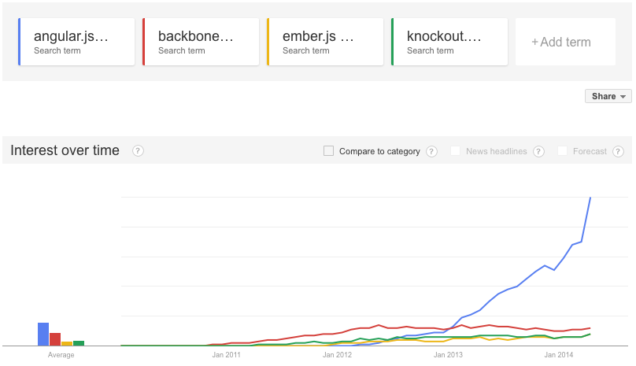
Why care? – Google trends
As of 4/3/2014
Notes:
Also most searches for Angular.js were done in the US

Slide 8
Why care? – GitHub Stats
As of 4/3/2014
 | Angular | Ember | Backbone | Knockout
Stars | 22,351 | 9,780 | 17,538 | 4,821
Watches | 2,225 | 828 | 1,455 | 425
Forks | 7,144 | 2,109 | 3,851 | 799
Commits past month | 859 | 266 | 123 | 89
Authors past month | 195 | 58 | 25 | 9
Major Releases past year | 21 | 15 | 3 | 4

Slide 9





Angular.js vs other libraries

Slide 10
vs
jQuery is a library meant for is DOM manipulation, animations and an AJAX wrapper. NOT an application framework
Pros
None. Angular has built in ‘basic’ jQuery.
  If full-blown jQuery is added Angular will automatically use it. Generally full blown NOT needed.
Cons
Horrible choice for creating dynamic UIs.
  Verbose code, hard to maintain, not organized
  Not MVVM or MVC

Slide 11
vs
Provides structure to web applications as well as model, view, templating, basic routing and RESTful interactions.
Pros
Older and more mature
Cons
“Previous generation” web app framework
  No MVVM w/o addons – use jQuery for DOM manip.
  No DI, not as easily testable
  Not a full-featured framework, meant to be ‘light’
  Extremely verbose for what you get
Not actively developed

Slide 12
vs
A library that provides MVVM data bindings using observables and dependency tracking
Pros
Possibly more performant under some situations
  Not in my experience however
Cons
Complicated and error prone
  Dependency tracking, computeds get confusing
  “when complicated things break it's hard to figure out why”
  No POJO. Have to create “types” and ko.observable()s
All it does is MVVM, not an app framework
  Testability, code organization etc. all potential issues

Slide 13

vs
A full-fledged framework for web applications
Pros
Similar goals as Angular.js
Cons
Uses observables, special objects, string getters and setters, not dynamic
Is ideal for LARGE web apps. Not intended for one off jQuery replacements
Is arguably more complicated
Very opinionated, have to use their object "bases"
Not as popular as Angular

Slide 14

Why I like Angular best
FLEXIBLE! As big or small as you want it to be
  Two line jQuery replacement to a MASSIVE enterprise app
POJOs make life so easy. No ‘observables’, wrappers etc. Uses dirty checking for 2-way binding.
  Fully embraces the dynamic nature of JavaScript
The community and popularity
Super efficient
DI, services, factories, providers offer flexibility and familiarity to traditionally server side paradigms
Directives offer DSL-like extension to HTML for your domain specific use cases
Scopes, although tricky, offer extreme flexibility

Slide 15
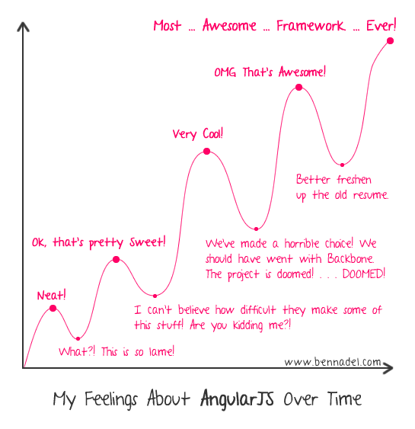
Why I don't didn't like Angular
Scopes are hard initially, but awesome
Learning curve === eventual productivity

Slide 16

Live Coding time!
A simple example
<blink>Please Help!</blink>

Slide 17
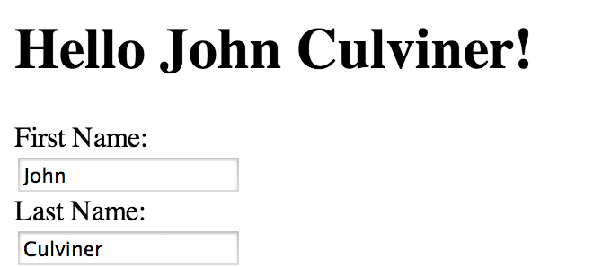
Simple example
ng-app attribute causes Angular to scan children for recognized tokens
Creates the “root scope” $rootScope
  $rootScope ≈ a ViewModel
Angular sees three “directives”
  {{firstName + " " + lastName}}
    Evaluated against the current $rootScope and updates the DOM on any change. "1 – way bound"
  ng-model="firstName"
    An input to be 2-way bound against $rootScope.firstName
  ng-model="lastName"
    An input to be 2-way bound against $rootScope.lastName

Slide 18
Original $rootScope:
Directives
Perform the 1 or 2 way binding between the DOM and the model ($rootScope)
$rootScope = {};
  {{firstName + " " + lastName}}
    Watch for $scope changes and reevaluate the expression
  ng-model="firstName"
    Watch for $scope.firstName changes, update the textbox
    Watch for textbox changes, update $scope.firstName
  ng-model="lastName"
    Watch for $scope.lastName changes, update the textbox
    Watch for textbox changes, update $scope.lastName
1-way bound
After typing:
$rootScope = {
firstName: “John”,
lastName: “Culviner”
};
2-way bound
2-way bound
Object fields and values are dynamically assigned by the bound directives.

Slide 19
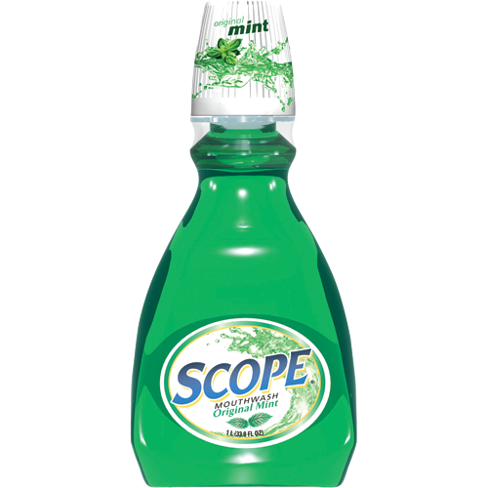
What is Scope?
Scope is an object that refers to the application model. It is an execution context for expressions. Scopes are arranged in hierarchical structure which mimic the DOM structure of the application. Scopes can watch expressions and propagate events. (from Angular website)
Key points
Scope is like a ViewModel that allows communication between JavaScript code and Views
{{firstName + " " + lastName}} is an expr executed against scope
Scope can be hierarchal with DOM nesting of directives
Watches can be used to watch for changes to scope ex:
  $scope.$watch("firstName", function(value) {
  //update the DOM with the new value
  });

Slide 20
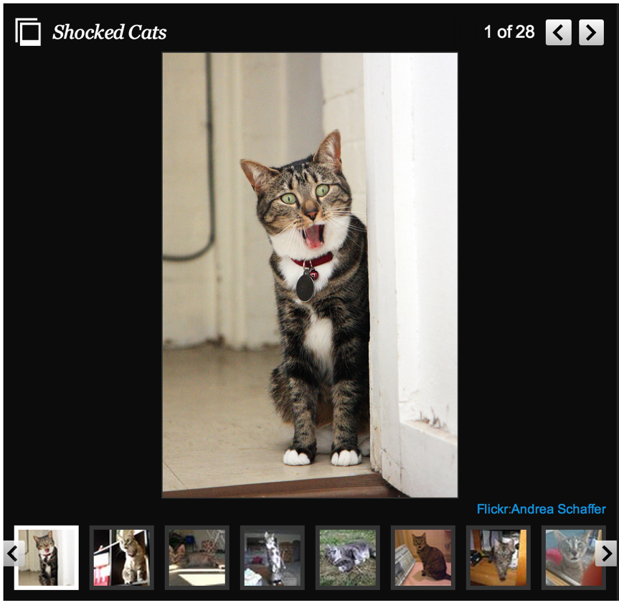
What is a Directive?
A reusable component for performing DOM interaction, templating and possibly two-way binding against $scope
  The ONLY place JS to DOM interaction should occur
Angular offers a huge amount of built in directives for common UI tasks, ex:
  <div ng-show="someBool">someBool is true!</div>
  2 way binding inputs, setting classes, foreach loops of elements, clicking etc.
You can write your own directives
for domain specific purposes
(a ‘DSL’ for HTML). Ex:
  <slideshow title="Shocked Cats">
    <slide src="cat1.jpg"></slide>
    <slide src="cat2.jpg"></slide>
    …
  </slideshow>

Slide 21

What is a Directive?
Or simply invoke an existing jQuery plugin
  <datepicker ng-model="aDate"></datepicker>
  Or if you need <=IE8 support:
  <input type="text" datepicker="" ng-model="aDate"/>
  Wrappers for jQuery UI components (ex: datepicker)
HUGE amount of directives out there due to Angular's popularity. Rarely have to write your own other than domain specific directives
  EX: AngularUI
    Twitter bootstrap wrappers
    Select2
    Sorting
    Input masking
    Enhanced router
    Etc…
  AngularAgility (my open source project)
    A set of useful Angular.js extensions implementing common UX patterns to improve productivity

Slide 22
Adding "status updates" with a Controller

Slide 23
What is a Controller?
A controller is really just a fancy name for a
"scope container" that prototypically inherits from its parent scope container.
A controller can interact with $scope (the 'view model') which the view can also interact with.
$rootScope = {
}
Person Controller
$scope = {
firstName: "John",
lastName: "Culviner",
statuses: [{…}, {…}, …]
}

Slide 24
Directives and Scope
A controller is really a directive that is configured to prototypically inherit from its parent
Directives can be configured for what type of scope they create and parent access they have
Use "AngularJS Batarang" plugin for Chrome to explore scopes
$rootScope = {
}
DIRECTIVE that prototypically inherits from $rootScope
Person Controller
$scope = {
firstName: "John",
lastName: "Culviner",
statuses: [
{ text: "foo", date: …},
{ text: "bar", date: …}
]
DIRECTIVE
ng-model="firstName" / "lastName"
Each use parent scope, no inheritance
DIRECTIVE
ng-repeat="status in statuses"
Each record gets its own scope that prototypically inherits from Person Controller scope

Slide 25
Fixing the ugly dates and ordering with Filters

Slide 26

What is a Filter?
A function that transforms an input to an output
  Reminds me a lot of LINQ extension method lambdas in .NET
Can be "piped" UNIX style
Can create own
Angular has many built in filters:
  currency
  date
  filter
  json
  limitTo
  lowercase
  number
  orderBy
  uppercase

Slide 27
Validation with ng-form

Slide 28

What is ng-form?
NOT a traditional HTML "form"
Requires a "name" and "ng-model" on each input you wish to validate
Angular will not push invalid values back into bound $scope
Allows for validation of collections of controls
Applies CSS classes to elements based on their validity
Lots of built in validator directives that work with ng-form:
  required=""
  ng-minlength="{number}"
  ng-maxlength="{number}"
  ng-pattern="{string}"
Angular UI has some extensions
AngularAgility - FormExtensions makes it easier

Slide 29
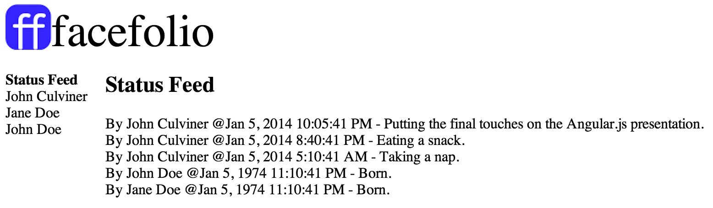
Facefolio Progresses....
Lets check it out

Slide 30

Facefolio Progresses…
A REST API around people and statuses has been created
People
  GET '/people' – get all the people in the DB
  POST '/people' – save a new person
  POST '/people/:id' – save existing person with :id
Statuses
  GET '/statuses' – get all statuses in the DB
  GET '/people/:id/statuses' – get all statuses for person
  POST '/people/:id/statuses' – save person status
  DELETE '/people/:id/statuses/:statusId' – delete a particular status

Slide 31
Facefolio Progresses…
File structure has been laid out more sensibly
  By functional area, NOT by type (like MVC)
    index.html – main layout with left navigation and top header
    /app
      /person
        person.html
        person.js
      /statusFeed
        statusFeed.html
        statusFeed.js
      app.js – app module definition, routing configuration
      index.js – controller code for index.html

Slide 32
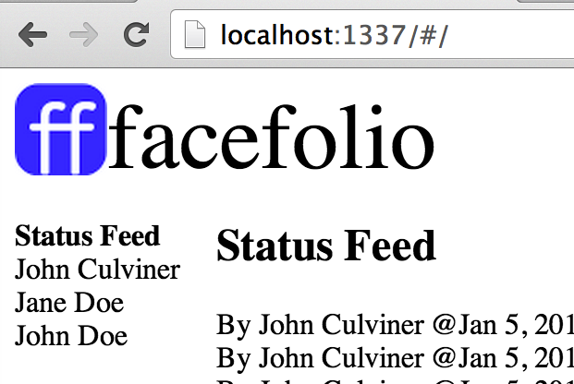
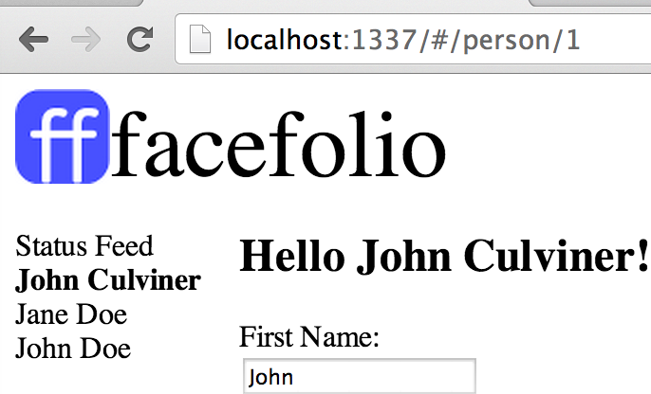
Facefolio Progresses…
Is now a Single Page App (SPA) with multiple "virtual pages"
The hash changes but DOESN'T cause a full DOM refresh
  Data loaded in with AJAX and JSON
Handled by AngularUI - Router

Slide 33
$resource for status CRUD

Slide 34
$scope .emit/.on for person name change

Slide 35
$scope .emit/.on
$rootScope = {
}
Index Controller
$scope = {
people: [{},{},{}]
}
Scopes can "message" parent/child scopes
  $scope.$emit(…)
  Message upward
  $scope.$broadcast(…)
  Message downward
  Here:
    When a person changes
    Notify the "Index" controller to refresh it's list (which has now changed)
DIRECTIVE (RENDERING HTML!)
ng-repeat="person in people"
John Culviner
Jane Doe,
John Doe
Hey someonechanged!
Refresh!
Person Controller
$scope: {
person: {
firstName: "John",
lastName: "Culviner
}
updatePerson: function()
{
//save a person
}
}

Slide 36
fieldLocker Directive

Slide 37
AngularAgility
A set of useful Angular.js extensions implementing common UX patterns to improve productivity
#1 Goal: Reduce/remove the maundane "every CRUD app I've made needs this stuff" code
#2 Goal: Configurability

Slide 38
AngularAgility Form Extensions
Generate Angular.js form fields, labels and rich validation messages with error notifications in one line of HTML
    A 'DSL' for Twitter Bootstrap (or whatever) because the markup is super verbose!
  Drastically reduce boilerplate HTML for form fields and validation messages
  Automatic form field validation message generation
Form changed tracking, form resets, loading indicators, on-navigate away handling

Slide 39
ANGULAR AGILITY
DEMO SITE

Slide 40

Questions/Comments?
John Culviner
GitHub: github.com/johnculviner
Blog: johnculviner.com
Twitter: @johnculviner
Email: john@johnculviner.com
FACEFOLIO CODE HERE:
https://github.com/johnculviner/IntroToAngularJS
ANGULAR AGILITY CODE HERE:
https://github.com/AngularAgility/AngularAgility

